Slide 1
Changes in Comed load profile data under covid-19: what is the new normal?
Amanda D. Smith, Casey D. Burleyson, Aowabin Rahman, Jennie S. Rice, and Nathalie Voisin
Pacific Northwest National Laboratory

Slide 2
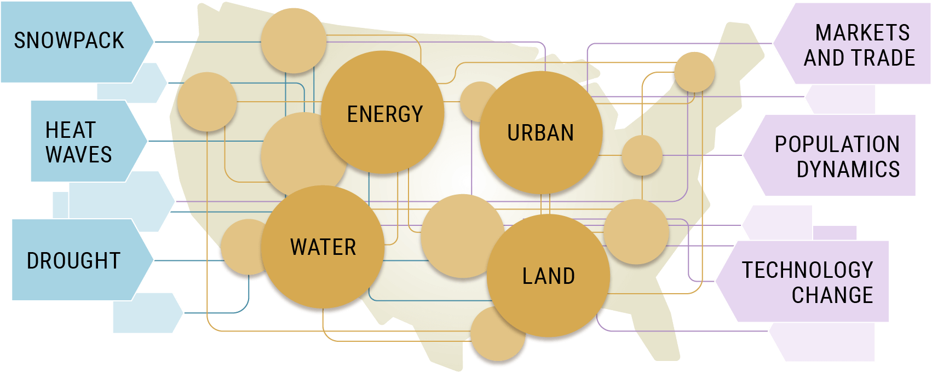
Background
Integrated Multisector Multiscale Modeling (IM3):
Multi-institutional effort supported by DOE Office of Science, MultiSector Dynamics program
Studying interactions between energy, water, land, and urban systems
Building ENergy Demand (BEND): Sub-project under IM3 simulating hourly electricity load profiles for buildings
Residential sector
Commercial sector
Motivation: Obtain load profiles that can be used to calibrate & validate BEND results.
Separation between residential & non-residential loads
Coverage at county scale or larger regions
Resolution of 1 hour or less

Slide 3
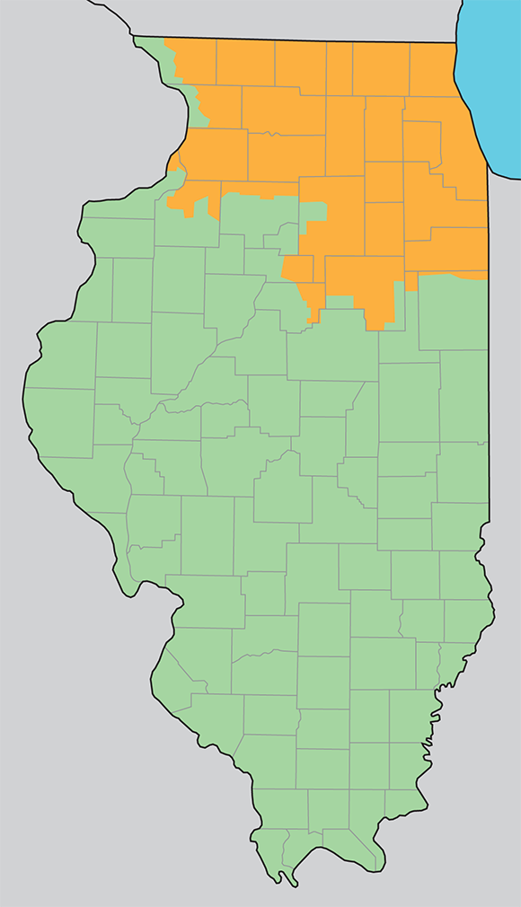
data Overview
Anonymous Data Service from ComEd (Exelon) https://www.comed.com/SmartEnergy/InnovationTechnology/
30-minute interval electrical energy usage data
Individual meters aggregated by zip code
Subject to 15/15 anonymization
Segregated by load class
Residential (4 classes)
Non-residential (11 classes)
April 2018 – September 2020
Fee-based with discount for non-profits, government, and grant-based research
(MC Squared Energy Services, LLC, 2020 https://www.mc2energyservices.com/about-us/service-map)

Slide 4
April 2018-2020: total load
Decrease in peak load magnitude in 2020
Midday peak
More gradual slope to the morning ramp in 2020

Slide 5
April: residential & non-residential loads

Slide 6
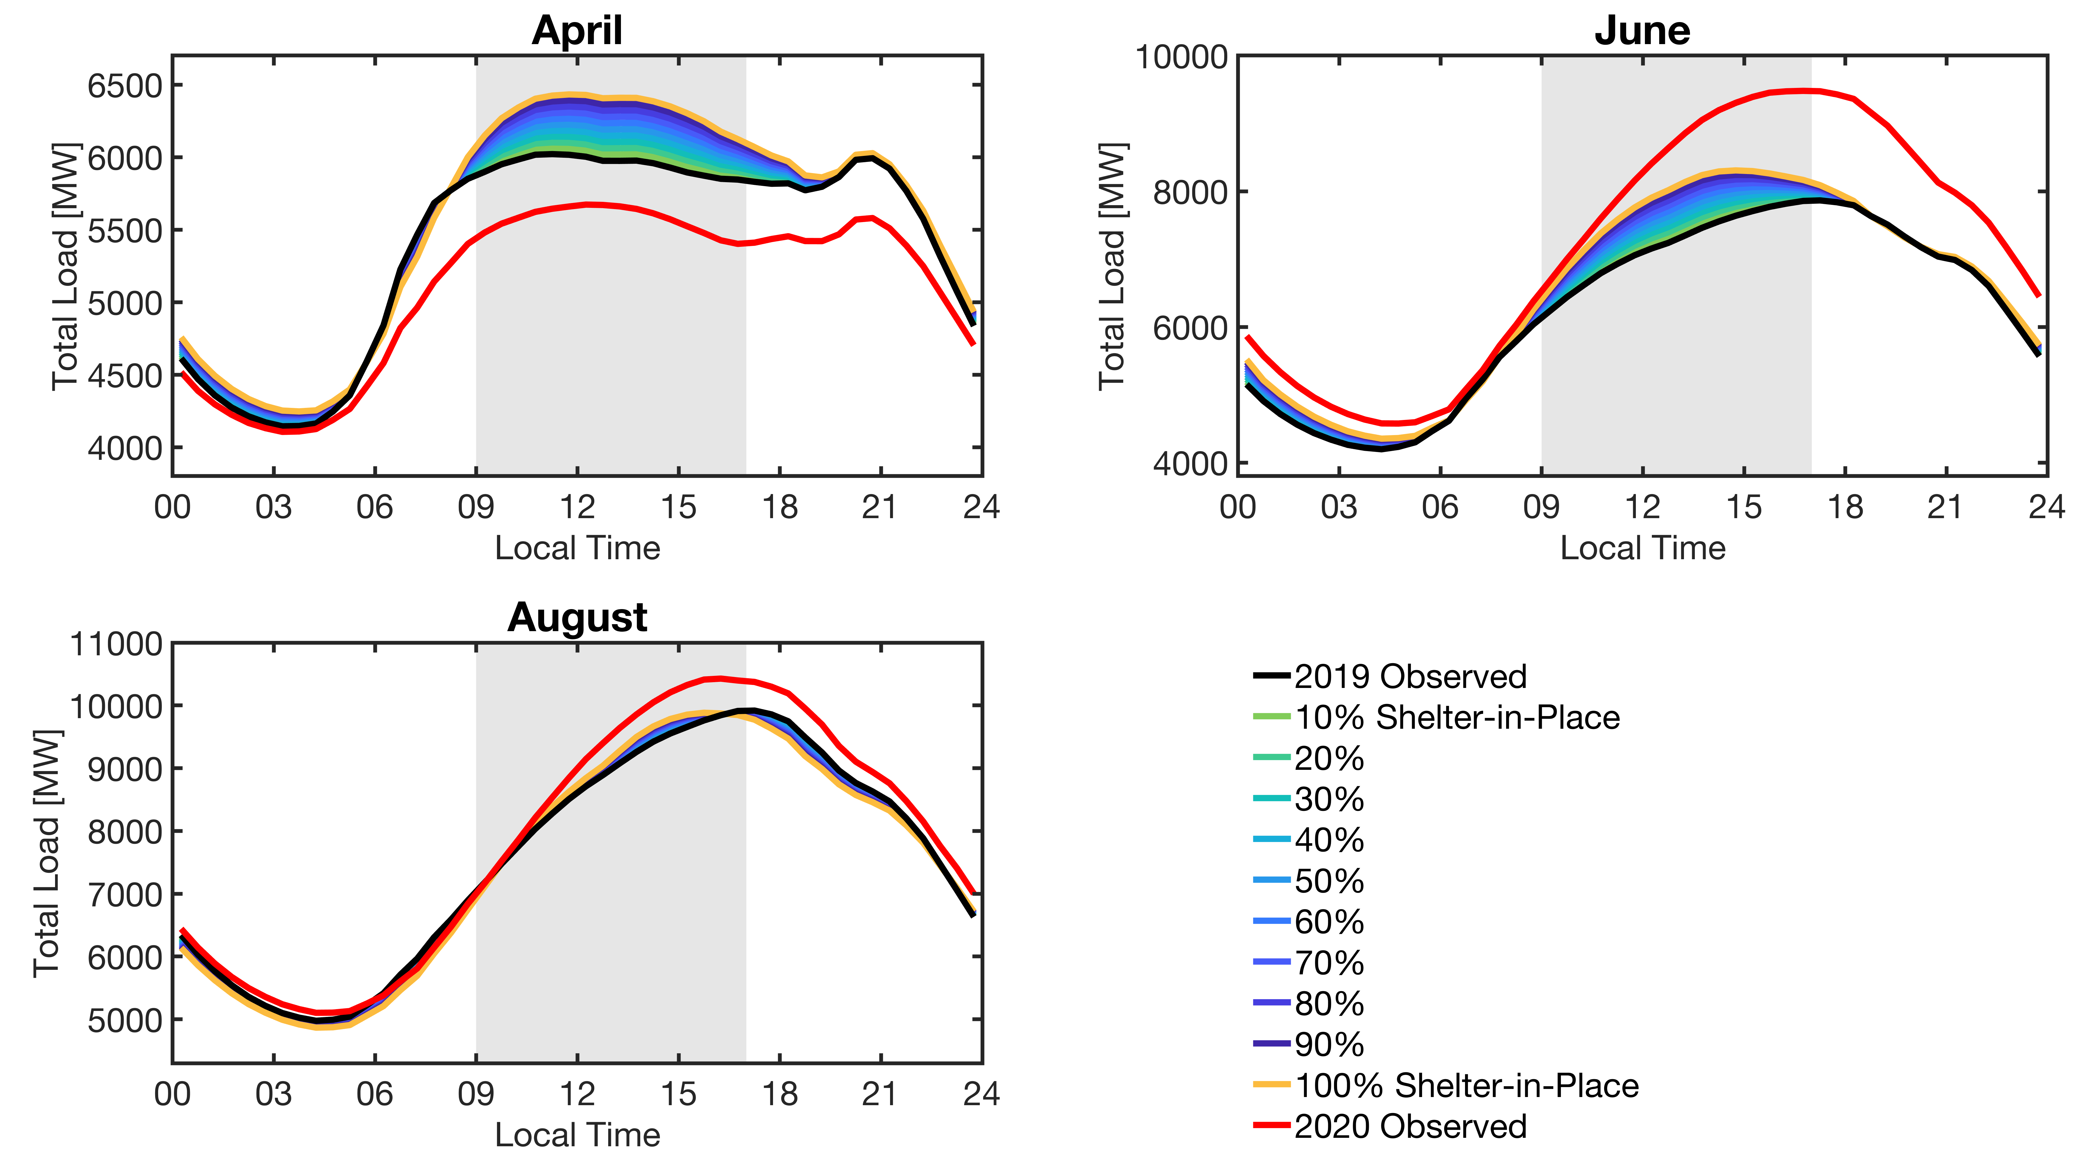
what we thought might happen: projections using historical load data from 2019
“2019 observed” is 0% Shelter-in Place.
For “100% Shelter-in-Place,” residential weekend load profiles are substituted in to replace residential weekday load profiles.

Slide 7
what happened: summer 2020 differed from adjusted profiles from previous years
WHY?
Loads vary year to year, regardless of pandemic conditions.
Weather
Load growth
Stochastic variation
Weekend days from previous years were the “old normal” weekends.
NYISO reported “patterns similar to what we would see during a widespread snow day.” (New York ISO, April 14, 2020, https://www.nyiso.com/-/covid-19-and-the-electric-grid-load-shifts-as-new-yorkers-respond-to-crisis)
Mitigation measures vary throughout ComEd’s service territory and throughout summer 2020.
Illinois government: “To prevent rapid spread of COVID-19, new mitigations may be applied on a regional basis.” (Illinois Department of Commerce & Economic Opportunity, 2020, https://dceocovid19resources.com/restore-illinois)
Previous analysis: Burleyson, C.D., Rahman, A., Rice, J.S., Smith, A.D. & Voisin, N. 2020. “Changes in Electricity Load Profiles Under COVID-19: Implications of “The New Normal” for Electricity Demand.” http://dx.doi.org/10.31224/osf.io/trs57

Slide 8
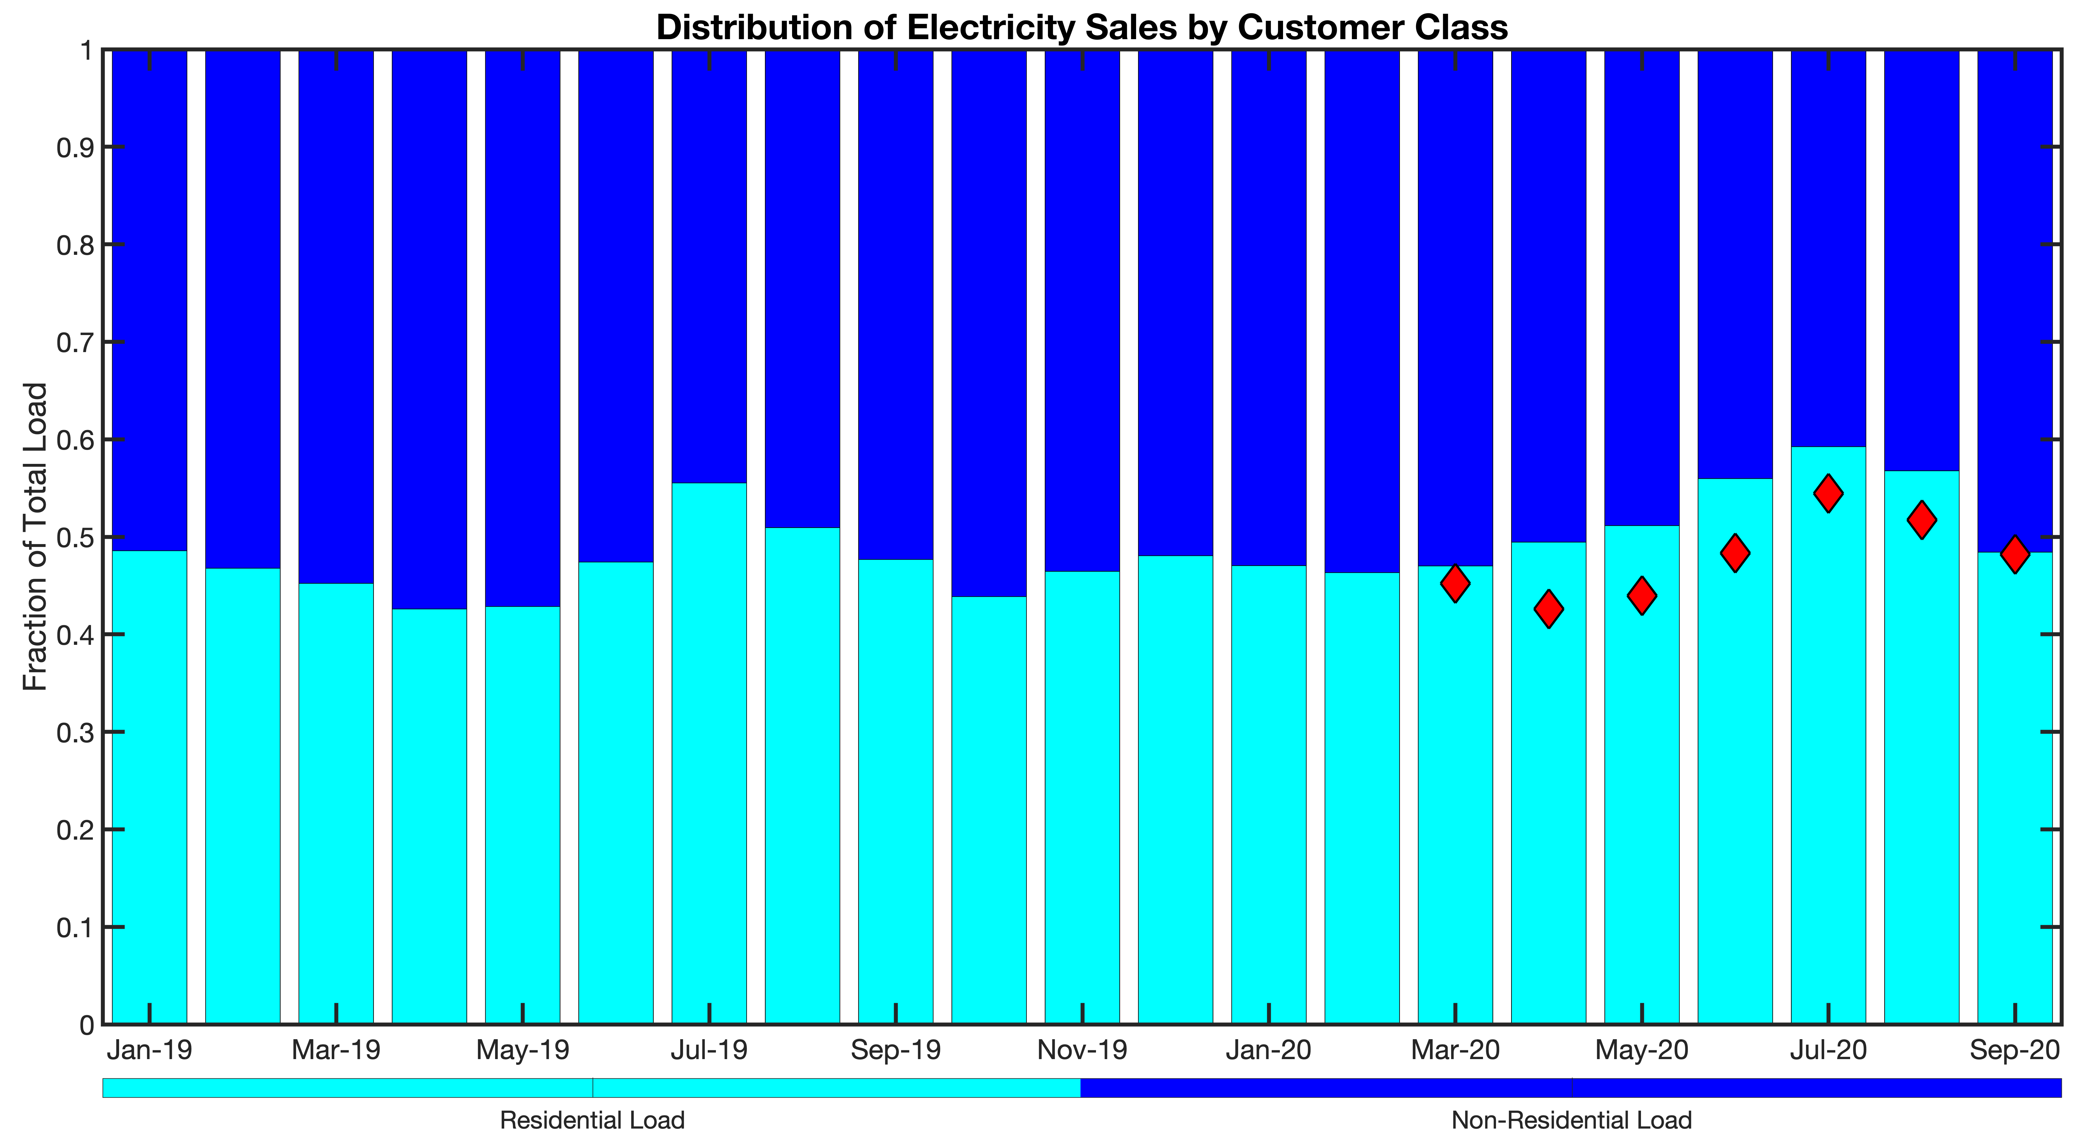
increase in residential proportion of load

Slide 9
June 2018-2020: total load
Increase in peak load magnitude in 2020
Similar timing of peak to previous years
Delay in beginning of morning ramp

Slide 10
June: residential & non-residential loads

Slide 11
august 2018-2020: total load
Similar weekday peak load magnitude in 2020 and 2018
Lower weekend peak load magnitude in 2020 than in 2018
Slightly earlier timing of peak than in previous years
Shape of 2020 load profile similar to previous years

Slide 12
August: residential & non-residential load

Slide 13
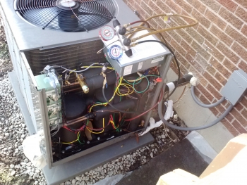
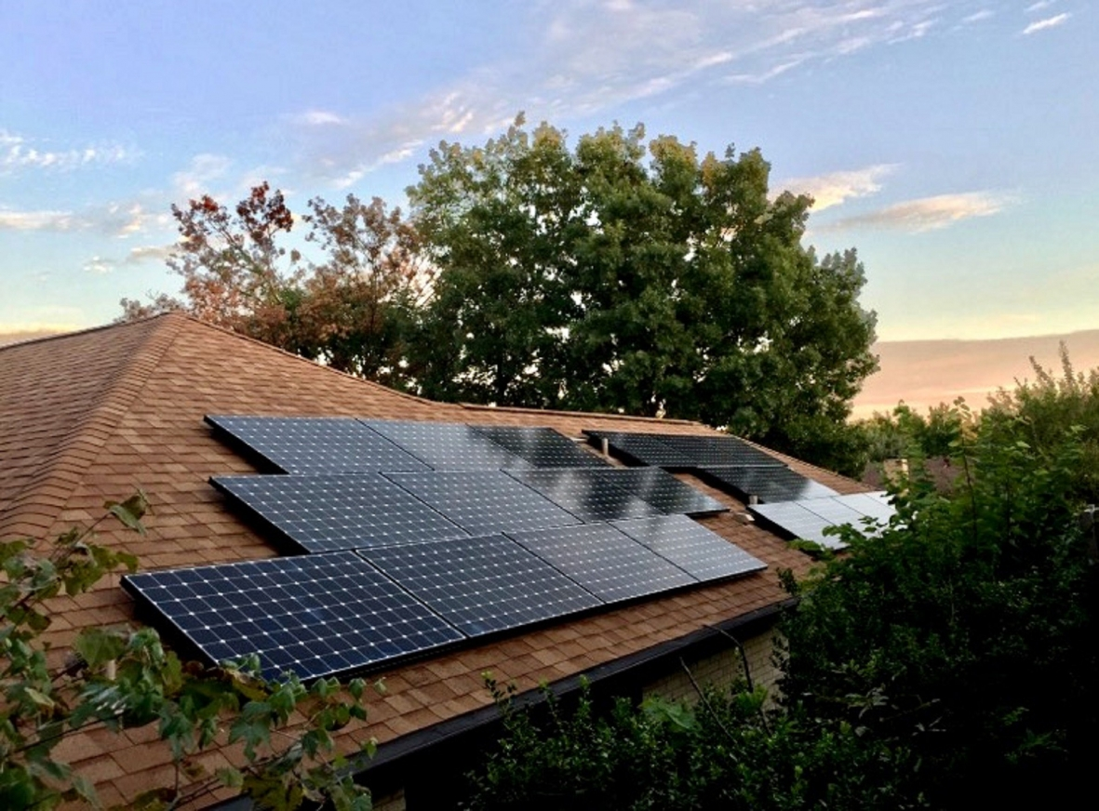
implications: electrification, renewables
Electrification: Increased adoption of heat pumps
Residential: Weekday stay-at-home boost in the midday load profile could be even more pronounced.
Heating demand increases without thermostat setbacks.
Heat pump performance is worse as temperatures drop.
Other electrification (e.g. cooking) adds to daytime demand.
Commercial: Buildings with low occupancy and few internal loads will have higher heating demands.
Renewables: Increased penetration of residential solar PV
Shift toward higher residential portion of the load could make residential PV slightly more favorable.
Evening ramp for residential loads on weekdays (the head of the “duck curve”) was not consistently more or less steep in April – September 2020.
Shift in timing of the peak residential loads was within the range expected from examining 2018-2019 data.

Slide 14
electric load data availability for research
Sharing load data can benefit the utility/organization:
Expansion of products and services available to grid customers
Analysis performed by specialists working together in areas such as building science, atmospheric science, decision science
New insights from questions posed by outside experts
Data can be shared in different ways:
Aggregated, anonymized
Free or fee-based
Publicly available, limited access, or single party
Openly shared, written limits on reproduction and use, or non-disclosure agreement
“Availability of data...will enable a growing sector of energy tech companies to design new products and pricing programs that will help customers save money and meet the growing interest for more choice and personalized services.”
ComEd 2017 press release https://www.businesswire.com/news/home/20170213005686/en/ComEd-Launches-Industry-Leading-Energy-Data-Product

Slide 15
key findings
After the onset of COVID-19 and Illinois’ shelter-in-place order:
Residential load profiles on weekdays changed to closely resemble profiles previously seen on weekends.
Morning ramp in residential loads occurred later in the day and was more gradual.
Nonresidential loads decreased, but not in direct proportion to residential increase.
Based on analysis of data from late March through September 2020:
Residential loads make up a greater fraction of the total load than in the same months in previous years.
Effect of the pandemic on nonresidential sector is not straightforward.
No evidence that timing of the peak loads shifted due to COVID-19 conditions.

